Slide 1


Green Skilling, Sustainability, Artificial Intelligence & SDG 17
R.N.G. Patel Institute of Technology, Bardoli
B.Tech Computer Science Engineering
Presented By | Enrollment No: 240840131149
Mehul Rakesh Patil

Slide 2



Agenda
Green Skilling
Sustainability
SDG 17
Skills for sustainable development, green jobs, renewable energy, and environmental protection in emerging industries.
Three pillars: Environmental, Social, and Economic sustainability — balancing growth with responsibility and resource protection.
Partnerships for the Goals — global collaboration among governments, industries, institutions, and citizens via technology.

Slide 3



Agenda Overview (Continued)
Learnings from Resources
Key insights from data centres, carbon emissions, ecological footprints, AI energy use, and green skills for future employment.
Data Centres & Environment
Understanding energy consumption, cooling systems, renewable-powered infrastructure, and AI-driven workload management.
AI for Sustainability
AI applications in smart agriculture, waste sorting, energy management, pollution monitoring, and climate prediction.

Slide 4









Agenda
Challenges of AI
High energy use, e-waste, carbon emissions, ethical concerns, and the need for Green AI practices.
Activities Completed
Data Centre Documentary, Ecological Footprint, Carbon Calculator, MIT Simulation, NANDO AI Bins, SCGJ Portal.
Capstone Project & References
EcoVision AI – Intelligent Waste Monitoring Platform, plus cited resources and acknowledgements.

Slide 5
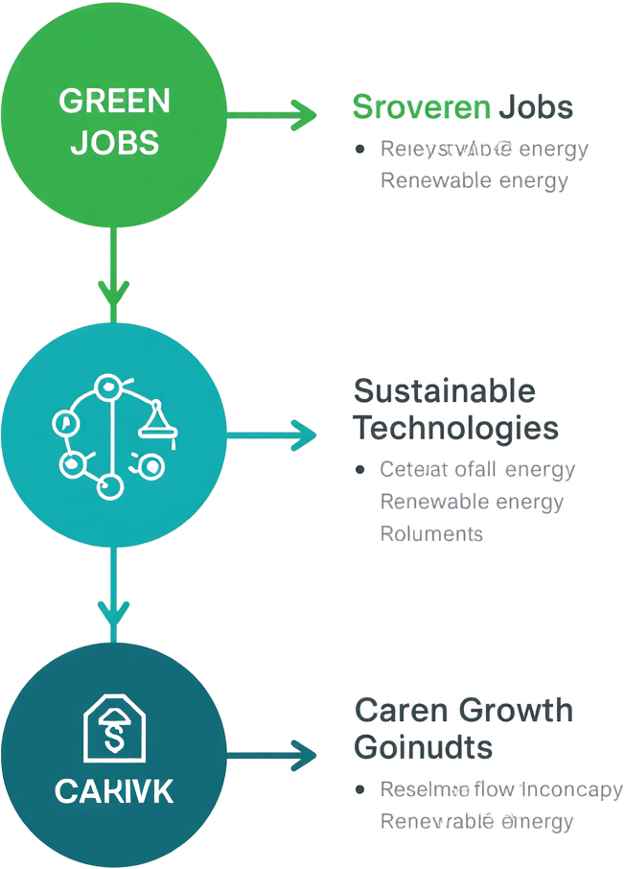




What is Green Skilling?
Sustainable Technologies
Proficiency in green tech tools—AI, IoT, smart grids—enabling efficient resource management and environmental protection.
Green Jobs
Skills that support environmentally sustainable economies, creating roles in renewable energy, conservation, and eco-
friendly industries.
Career Benefits
Green skills boost employability in fast-growing sectors, aligning with global sustainability goals and SDG targets for 2030.
Renewable Energy Skills
Technical expertise in solar, wind, and clean energy systems that power a sustainable future and reduce carbon
emissions.

Slide 6




The Three Pillars of Sustainability
Environmental Sustainability
Protecting natural resources, preserving biodiversity, reducing pollution, and ensuring a healthy planet for future generations.
Social Sustainability
Promoting equity, community wellbeing, social justice, access to education, and inclusive growth for all people.
Economic Sustainability
Enabling responsible economic growth, creating green jobs, supporting fair trade, and balancing development with environmental limits.

Slide 7



SDG 17 – Partnerships for the Goals
Governments & Industries
Governments set policies and funding; industries drive innovation and implement sustainable technologies at scale.
Educational Institutions & Citizens
Universities build green skills; citizens adopt sustainable habits and hold institutions accountable for SDG progress.
Technology & AI Role
AI and digital tools accelerate SDG achievement through data-driven decisions, smart resource management, and global knowledge sharing.

Slide 8
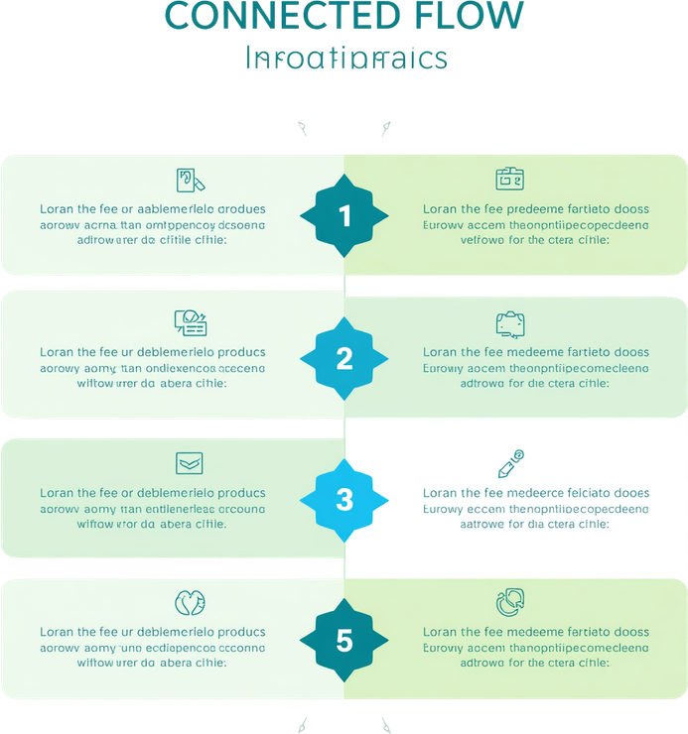




Learnings from the Provided Resources
Ecological Footprint Awareness
Personal footprint calculators reveal individual environmental impact, raising awareness and encouraging responsible lifestyle choices for sustainability.
Data Centres & Energy
Data centres consume massive electricity for powering servers and cooling systems, making energy efficiency a critical
sustainability priority.
AI for Sustainability
AI optimises energy consumption, manages waste intelligently, and drives smarter resource use across industries to support sustainable development goals.
Carbon Emissions Reduction
Adopting renewable energy sources significantly reduces carbon emissions and helps organisations move toward net-zero environmental impact.

Slide 9



Data Centres & Sustainability
High Energy Consumption
Renewable Energy Data Centres
AI-Driven Workload Management
Data centres consume massive electricity to power servers and cooling systems, contributing significantly to global carbon emissions.
Emerging trend: data centres powered by solar and wind energy, enabling green cloud computing and reduced carbon footprint.
AI optimizes server workloads, balances energy demand, and reduces idle power usage — making data centres smarter and greener.

Slide 10
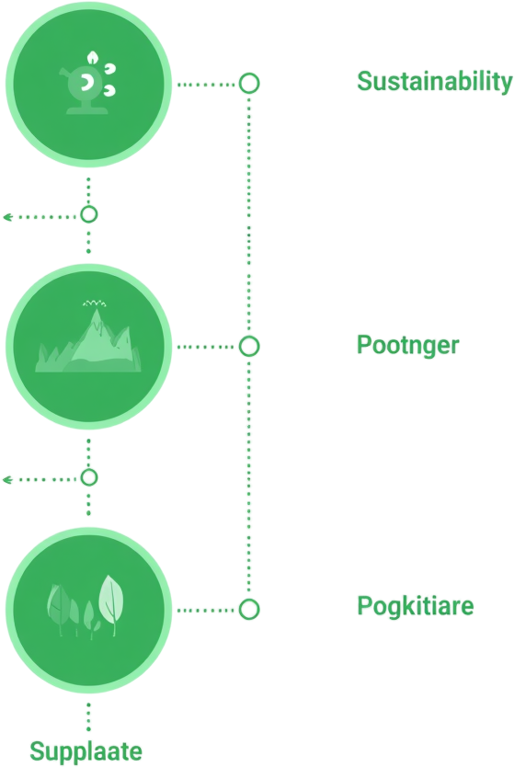




AI for Sustainability
Smart Energy & Pollution Monitoring
AI manages energy demand response and grid optimization. Air and water quality sensors provide real-time pollution tracking for healthier environments.
Smart Agriculture & Waste Sorting
Precision farming uses AI to optimize irrigation and crop yields. Automated waste sorting enables smarter recycling and
reduces landfill burden.
Climate Prediction & Smart Cities
AI climate models forecast global warming scenarios and policy impacts. Smart city integration enables sustainable urban management across energy, transport, and waste.
Forest Fire Detection & Water Conservation
AI-powered early warning systems detect forest fires in real time. Usage analytics help conserve water resources and
reduce wastage.

Slide 11



Challenges of AI
Energy & Infrastructure
AI training requires massive electricity. Data centres demand large-scale infrastructure, cooling systems, and continuous power supply.
E-Waste & Carbon Emissions
Hardware turnover generates electronic waste. AI lifecycle contributes significantly to carbon emissions and environmental degradation.
Ethics & Green AI
Ethical concerns around AI deployment persist.
Adopting Green AI practices is essential to reduce environmental impact responsibly.

Slide 12
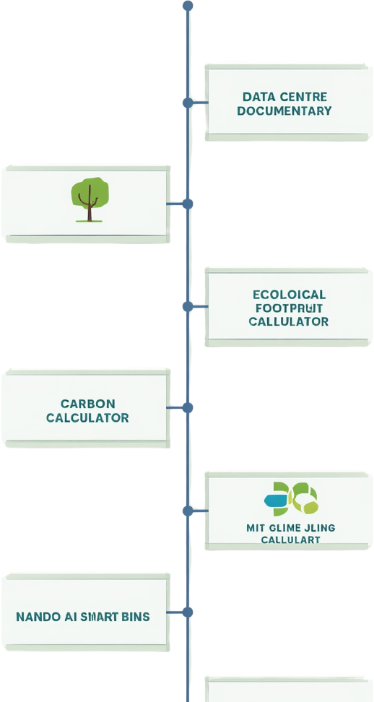
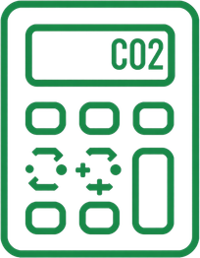



Activities Completed
Carbon Calculator & MIT Climate Simulation
Calculated personal carbon emissions and explored MIT En-ROADS climate simulator to visualize how policy decisions affect global warming scenarios.
[Insert Screenshot Here]
Data Centre Documentary
Watched a documentary on how data centres operate, consume energy, and impact the environment. Key insight: cooling systems account for major electricity use.
[Insert Screenshot Here]
NANDO AI Smart Bins & SCGJ Portal
Explored NANDO AI automated waste sorting bins and the Skill Council for Green Jobs (SCGJ) portal for green career opportunities.
[Insert Screenshot Here]
Ecological Footprint Calculator
Used an online tool to measure personal ecological footprint. Learned how daily habits contribute to resource consumption
and carbon output. [Insert Screenshot Here]

Slide 13



Key Learnings
Sustainability & Responsible AI
Sustainability is everyone's responsibility. Responsible and ethical use of AI is essential to ensure technology serves people and the planet.
Green Skills & Data Centres
Green skills enhance employability in future job markets. Data centres must transition to renewable energy sources to reduce their carbon footprint.
SDG 17 & Global Impact
SDG 17 requires collaboration across sectors and citizens. Individual small actions collectively create significant positive global impact.

Slide 14





Capstone Project – EcoVision AI
Technologies Used
Python, TensorFlow, OpenCV for AI/ML core. React & Node.js for frontend/backend. MongoDB for data storage and analytics.
AI Waste Detection & Recycling
Automatically identifies and classifies waste using computer vision, and provides smart recycling suggestions to
reduce landfill impact.
Future Scope
Integration with Smart Cities and IoT sensors. Government collaboration for policy support and large-scale environmental monitoring expansion.
Carbon Dashboard & Awareness
Estimates carbon footprint in real time and promotes sustainability awareness through analytics and environmental
monitoring tools.

Slide 15



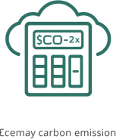

References
Data Centre Documentary
YouTube documentary exploring how data centres operate, their massive energy consumption, cooling challenges, and the push toward greener infrastructure solutions.
Ecological Footprint Calculator
Online tool used to measure personal ecological footprint, helping individuals understand their environmental impact and identify areas for sustainable lifestyle improvement.
Carbon Calculator
Interactive calculator used to estimate personal or organizational carbon emissions from daily activities, travel, and energy use, promoting carbon-conscious decision making.

